Slide 1
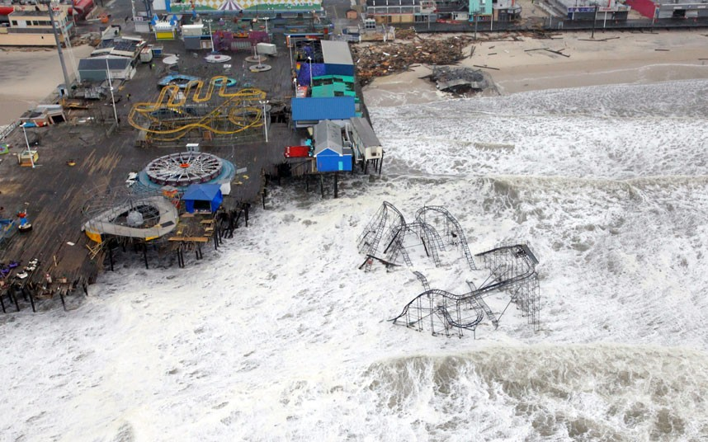
“The Role of 211 Systems in Disasters and Coordinating the Work of Human Service Agencies - Experiences from Recent Events “
“The Role of 211 Systems in Disasters and Coordinating the Work of Human Service Agencies - Experiences from Recent Events “
“The Role of 211 Systems in Disasters and Coordinating the Work of Human Service Agencies - Experiences from Recent Events “
“The Role of 211 Systems in Disasters and Coordinating the Work of Human Service Agencies - Experiences from Recent Events “
The Role of 2-1-1 Systems in Disasters and Coordinating the Work of Human Service Agencies - Experiences from Recent Events
Laura Zink Marx
Executive Director, NJ 2-1-1 Partnership

Slide 2

NJVOAD History
NJVOAD in its current form began after Hurricane Andrew in 1992
NJVOAD hosted the National VOAD Conference in Atlantic City in 1998
Tropical Storm Floyd – September 1999
9/11 – NJIPDR (NJ Interfaith Partnership for Disaster Recovery) was formed
Floods, floods and more floods
Hurricane Irene – August 2011
Hurricane Sandy – October 2012
Localized and regional events

Slide 3
How Does It Work
    Need Organizational Structure That Reflects Reality – outlined in the by-laws
    Identify Role and Responsibilities Before a Disaster
    Play to the Strengths of Each Organization
    Decide How the Group Communicates: before, during and after a disaster
    Keep Lines of Communication Open
    Collaboration a Must – no one organization can do it alone

Slide 4



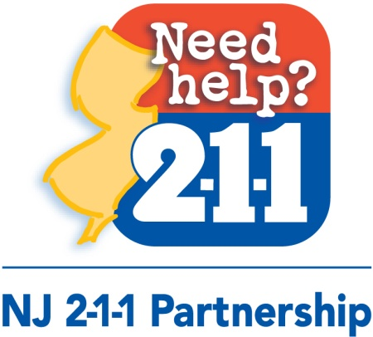
NJVOAD Executive Committee

Slide 5
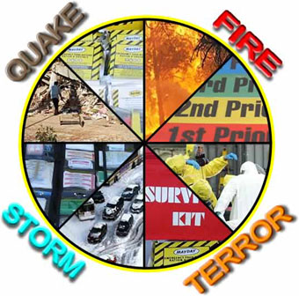
NJVOAD Planning & Preparedness Roles
County and Regional VOADs / COADs Development (Voluntary or Community Organizations Active in Disaster)
Emergency Service Function (ESF) Planning & Exercises
National Mass Care Strategy

Slide 6
Collective Strength
Every Organization has a Strength, Plan Around It
Red Cross: Mass Care
Community Food Bank: food distribution and meal preparation
Baptists & Salvation Army: Famous Mobile Kitchens
Catholic Charities: Case Management & Long-term Care
Mennonites: Start-to-finish Rebuilding
Mormon Helping Hands: Large numbers of unskilled laborers
2-1-1s: 24/7 information portal, advanced technologies

Slide 7
Disaster Response and Recovery
Advance planning / convening pre-disaster
Activation of the NJVOAD reflects the “home rule” process utilized throughout NJ.
      County or regional VOAD(s)/COAD(s) (Voluntary or Community Organizations Active in Disaster) will be the first to identify and address the needs for localized disasters. NJVOAD can support if asked
      Regional or statewide events will likely trigger NJVOAD convening to mobilize resources needed for the affected population
Long Term Recovery Groups (LTRGs) – develop out of the COAD or through NJVOAD efforts, provides organization around disaster services and unmet needs

Slide 8
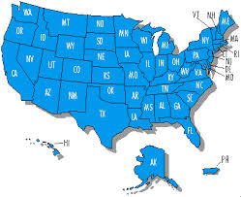
National Partners
Adventist Community Services
American Disaster Reserve
American Red Cross
Buddhist Tzu-Chi Foundation
Catholic Charities
Church of Jesus Christ of Latter Day Saints
Church World Services
Episcopal Disaster Relief
FEMA
ICNA Relief USA
Lutheran Social Ministries
National VOAD
Presbyterian Disaster Assistance
The Salvation Army
United Methodist Church
United Sikhs

Slide 9
Statewide Partners
American Radio Relay League
Association of NJ Volunteer Centers
Center for Non-Profit Corporation
Community FoodBank of NJ
Council of New Jersey Grantmakers
Family Support Centers of NJ
Family Resource Network NJ Caregivers
Goodwill Industries of Greater NY and Northern NJ
Governor’s Office on Volunteerism
H.E.A.R.T. 9/11
Homeless to Independence
International Institute of NJ
Islamic Society of NJ
Jersey Cares
Legal Services of NJ
NJ 2-1-1 Partnership
NJ Business Force – BEOC Alliance
NJ First Aid Council
NJ Interfaith Partnership for Disaster Recovery
NJ Motor Truck Association
NJ Office of Emergency Management
NJ Psychiatric Association
NJ State Police
NJ Task Force 1
Norwescap RSVP Volunteer Resource Center
Pass It Along
Voices of September 11
Volunteer Management Centers

Slide 10
Long Term Recovery Support
Five ongoing conference calls 19 months after Hurricane Sandy, over 1000 meetings to date
  Case Management
  Spiritual Care
  VOAD General Call
  Volunteer Coordination
  Construction and Donations Management
Dedicated Staff for Sustaining LTR Activities
  NJ 2-1-1 Fiscal Agent and LTR Program Coordinator
  15 LTR Groups today
  Hurricane Sandy Recovery Coordinator works with each LTRG
  10 VISTAs deployed to each LTRG and for COAD development
Work with NJOEM to revisit ESF responsibilities, moderate issues, and focus on preparing for the next event.

Slide 11
Challenges
Response: first days
  Communication, clear messaging
  Health and Medical Concerns, Isolated Individuals
  Housing and Power and Gasoline, shear magnitude of the event
  Sheltering
Response: first weeks
  Clean-up groups arriving without warning in NJ, Spontaneous volunteers
  Terminology: assessment (damage versus clean-up versus rebuild)
  Hired workers arriving without accommodations and funds
  Donations management
  Housing of residents and volunteers
  Counties without COADs needing organization to launch Long Term Recovery Efforts
  Mold, Debris
Recovery
  Home Rule: licensing of professionals, volunteers
  Building processes with LTR Groups
  Disaster Case Management, financial assistance
  Need for dedicated staff (as organizations had to get back to business as usual)
  Underserved populations
  Flood maps and elevation
  Slow release of assistance funds……………….
Notes:
11

Slide 12

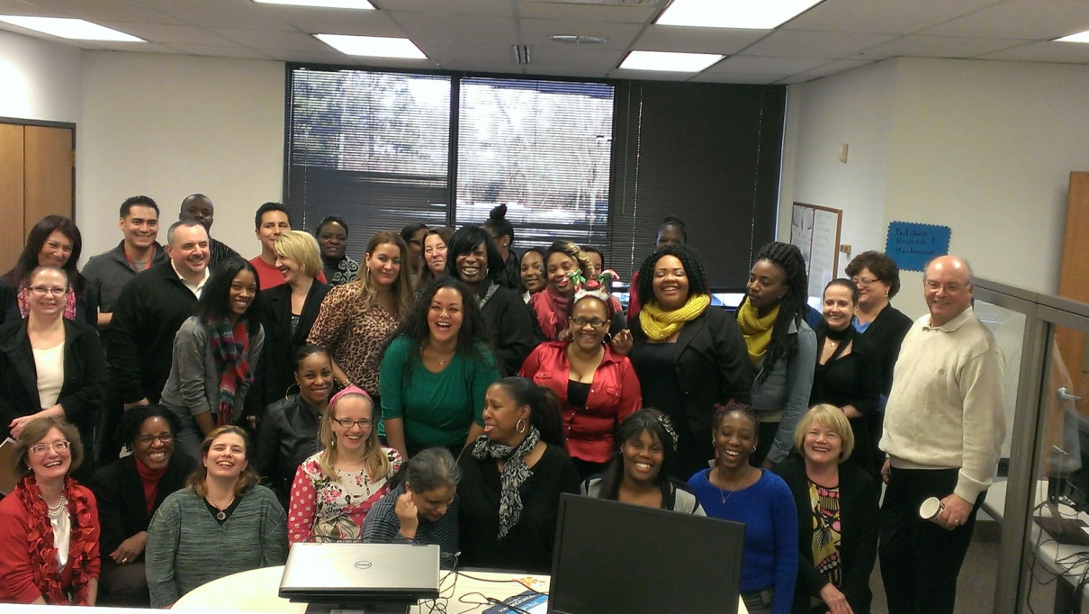
Who and Where …
NJ 2-1-1 Partnership
83 Staff Members, 56 FTE of which 50% are certified or licensed professionals. Statewide Service 24/7/365

Slide 13


Technologies – built with continuity of operations objectives
Web Based: Telecom (Five9),
Caller Management System and
Data Resources (Referral &
Resource House)
Premise Based (redundancy):
Telecom (IP Office), Referral and
Resource House Installed on
our servers
Phone App: Resource House
Communication Delivery: T-1s and FIOS that have back up capability

Slide 14

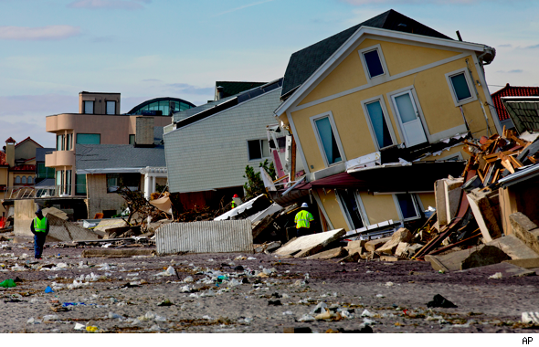
Continuity of Operations
COOP Plan To Do Checklist
Testing Implementation
Sustainability Over Time

Slide 15
NJ 2-1-1 Role in a Disaster
Contractual & ESF 2 Obligations
Public Information Portal
  By dialing 2-1-1 or visiting www.nj211.org
  Assistance Guides: Floods, Hurricanes, Haitian Earthquake
  Collect caller needs and trends
Addictions Hotline: point of contact for Medical Maintenance: methadone etc
CDC FluOnCall Participant: national response system
UVIS – Uniform Victim Identification System
Supportive Role
NJVOAD member and Fiscal Agent
Morris Co COAD member
Add callers to CrisisCleanUp.org
Work with Other State Departments on How to Leverage 2-1-1 for
immediate disaster needs (Dept of Health using the 2-1-1 portal, ivr messaging)
AND to get back to Business as Usual

Slide 16
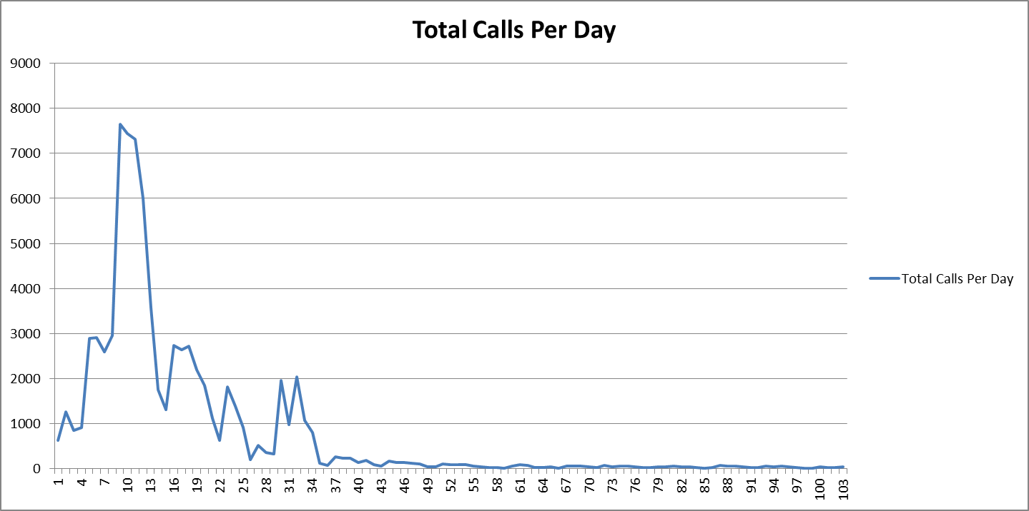
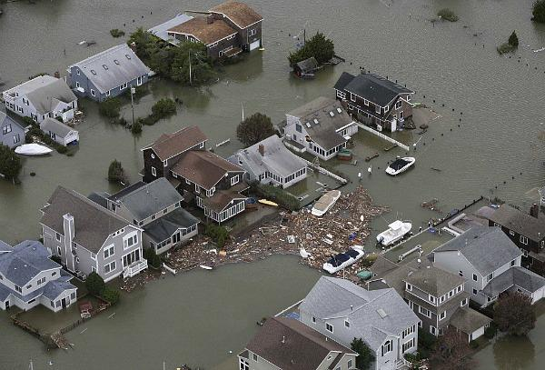

#1 Challenge: Handling the Surge

Slide 17
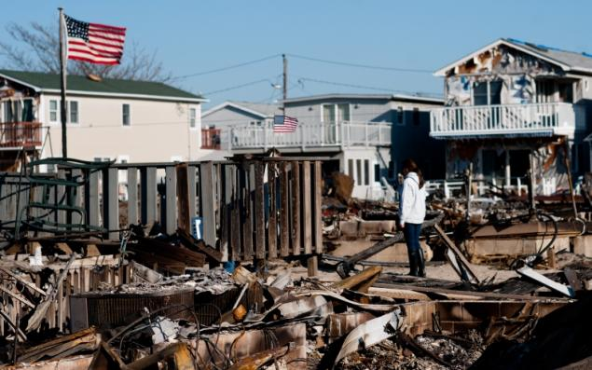

Hurricane Sandy Preparation
Shelter in Place: staff volunteer, food,
cots, blankets
Send some staff home in case of power
outages
Set up emergency operations room with 20 workstations
Planning call with Back-Up 2-1-1(s)
Reviewed our Continuity of Operations Plan with management team
Tested Technologies

Slide 18
Hurricane Sandy Calls
October 28 – December 31, 2012
Received over 85,000 calls (85% in first three weeks). Another 70,000 calls since Jan 2013.
Volunteers (Medical Reserve Corp, AmeriCorps, Spontaneous Volunteers) logged 5,783 calls and 590 hours a value of $12,390.
Back Up From 2-1-1 Palm Beach, Houston 2-1-1 and Vermont 2-1-1 (voice mails), 12,000 calls fielded by our partners
Web site saw 143,337 unique visitors viewed 281.902 web pages dedicated to Hurricane Sandy resources. Of those visitors 78% were new to the nj211.org website.
Top Needs included food replacement, sheltering, power outages, disaster food stamps & FEMA rumor control, disaster services (evacuations, emergency requests related to electrical outage), FEMA registration information, clean-up requests, local services, donations, and volunteering.
Developed an 83 page Hurricane Sandy Relief and Recovery Guide that is available at all DRCs, downloadable and web based for disaster case managers and others working with survivors in the field http://www.nj211.org/images/HurricaneSandy/NJ211HurricaneSandyResourceGuide.pdf
Thousands of callers registered for CrisisCleanUp.org

Slide 19

Long Term Recovery Role
Dedicated staff that register Hurricane Sandy survivors for long term recovery Disaster Case Management with Catholic Charities (FEMA Program) ends October 2014.
ReNew Jersey Stronger Assistance Hotline for HUD programs for residents and landlords. 11,000 still on one waiting list.
Rebuild, Outreach and Volunteer Coordination staff helping support NJVOAD and LTRG. Over 400K spent to date.
Fiscal Agent for NJVOAD – financial oversight and program coordination for 10 VISTA volunteers. High federal compliance standards.
Long Term Recovery Guide continues to be updated 19 months later.

Slide 20
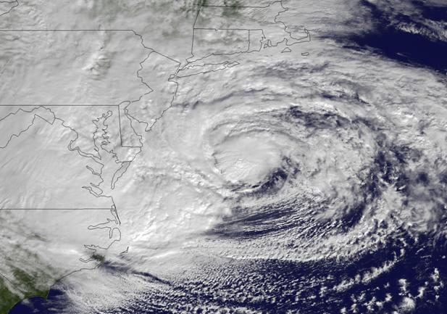
Questions?
Laura Zink Marx
lmarx@nj211.org
973-929-3704

