Slide 1
Religious Literacy and Competency
Engaging and Working With Faith Communities in Crisis Settings
Best Practices in NYC & Nationally

Slide 2
An Imperative from FEMA
“We need to move away from the mindset that federal and state governments are always in the lead, and build upon the strengths of our local communities…”
“When disaster strikes, the initial services provided may not come from government, but rather from churches, synagogues, mosques and other faith-based and community organizations…FEMA is working to improve our preparedness through the Whole Community framework.”
“When the community is engaged in an authentic dialogue, it becomes empowered to identify its needs and the existing resources that may be used to address them.”
--W. Craig Fugate, FEMA Administrator

Slide 3
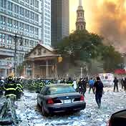
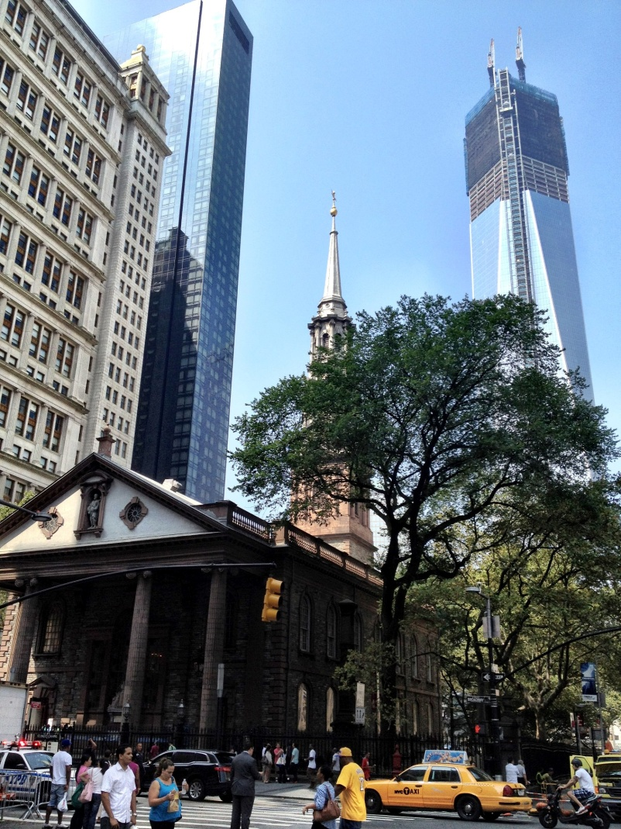
How Did I Get Here?

Slide 4
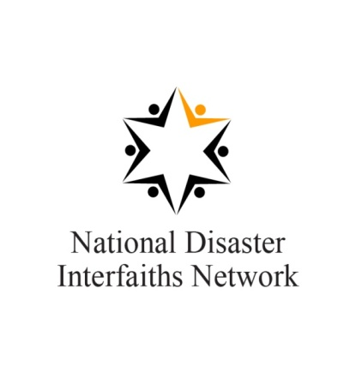
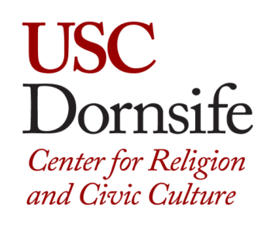
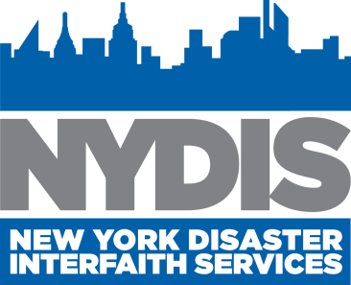
Peter B. Gudaitis, M.Div., President, National Disaster Interfaiths Network Chief Response Officer, New York Disaster Interfaith Services Adjunct Professor, Hartford Seminary Research Associate, USC Center for Religion & Civic Culture 4 West 43rd Street, Suite 407 New York, NY 10036 pgudaitis@n-din.org │www.n-din.org

Slide 5
Rationale For Faith-Base Engagement
If FEMA does not competently engage faith communities throughout the disaster lifecycle, those communities will be less resilient in the face of a disaster.
Faith communities will respond to disasters in their own ways, some of which will be effective. Other modes of response, however, may be ineffective and even harmful if not coordinated.

Slide 6
An Imperative to Engage From Communities
60% of Americans turn first to their religious leaders for advice and direction*; in low-income and immigrant communities, this percentage has been found to be even higher.
“2001 Ripple Effect,” American Red Cross

Slide 7
Assets of Faith Communities in Disasters
Trust: Moral authority, legitimacy, mission to serve
Resources: Space, people, money, capacities, and national affiliates
Knowledge: Language, cultural competency and an intimate knowledge of people and opportunities
Networks: Reach beyond their own congregations into larger communities
Programs: Human services, disaster volunteers
Staying Power: Longevity in community recovery
Notes:
Moral authority: Ex: In Mississippi, during Katrina, there was a pastor who told congregations if they obeyed evac orders they did not have faith in Jesus. So moral authority can have positive or negative implications. Another example is Imam in LA who told congregants not to take H1N1 vaccine as it was a pork product.
Communications networks: Prayer trees
Physical space: often have things like parking lots, large rooms for distributing emergency supplies

Slide 8
American Religious Mosaic

Slide 9
Evolving Religious Landscape
Adapted from Pew Forum on Religion and Public Life – Commitment Analysis December 2009
Notes:
Students taking this course should know how to start the Approval and Collect Feedback workflows and understand how they work. Or, they can take the Microsoft Office Online training presentation titled, “Workflows I: Basics you should know” and “Workflows II: Collect feedback for a file.”
[Notes to trainer:
For detailed help in customizing this template, see the very last slide. Also, look for additional lesson text in the notes pane of some slides.
Adobe Flash animations: This template contains Flash animations. These will play in PowerPoint 2000 and later. However: If you want to save this template in PowerPoint 2007, save it in the earlier PowerPoint file format: PowerPoint 97-2003 Presentation (*.ppt) or PowerPoint 97-2003 Template (*.pot) (you’ll see the file types in the Save As dialog box, next to Save as type). Warning: If you save it in a PowerPoint 2007 file format, such as PowerPoint Presentation (*.pptx) or PowerPoint Template (*.potx), the animations won’t be retained in the saved file.
Also: Because this presentation contains Flash animations, saving the template may cause a warning message to appear regarding personal information. Unless you add information to the properties of the Flash file itself, this warning does not apply to this presentation. Click OK on the message.]

Slide 10
The American Religious Landscape
90% of Americans say they are religious or spiritual
43% say they attend worship services regularly
At approximately 345,000 U.S. houses of worship
105,000 non-religious schools and universities
200 religious traditions in the U.S. with representation from almost every major world religion.
75% of Americans self identify as Christian
Landscape evolved rapidly (Since 1965 Immigration Act )
Sources: http://religions.pewforum.org/reports, http://www.rcms2010.org/

Slide 11
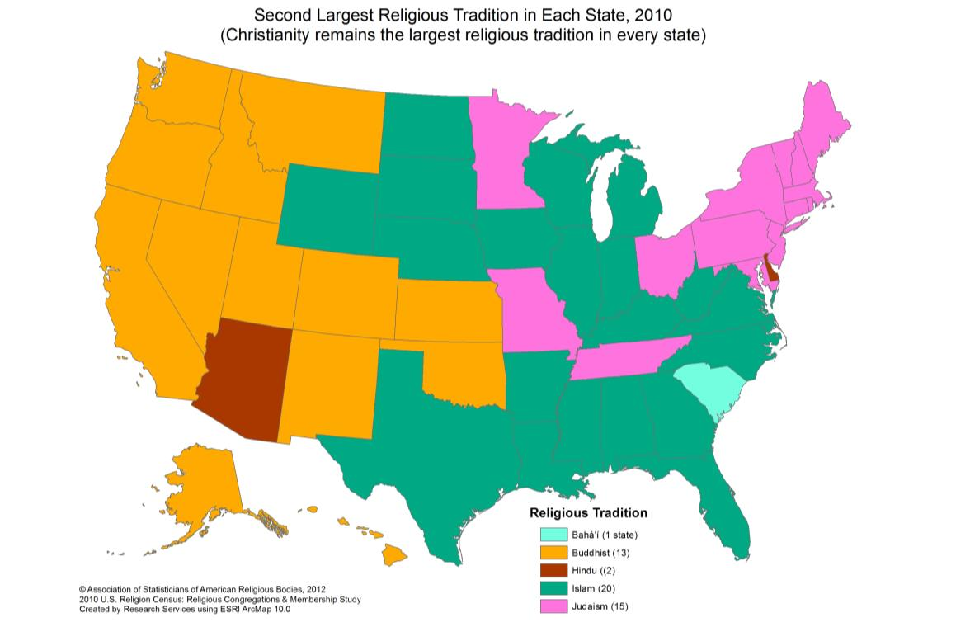
Second Largest Religion by State

Slide 12
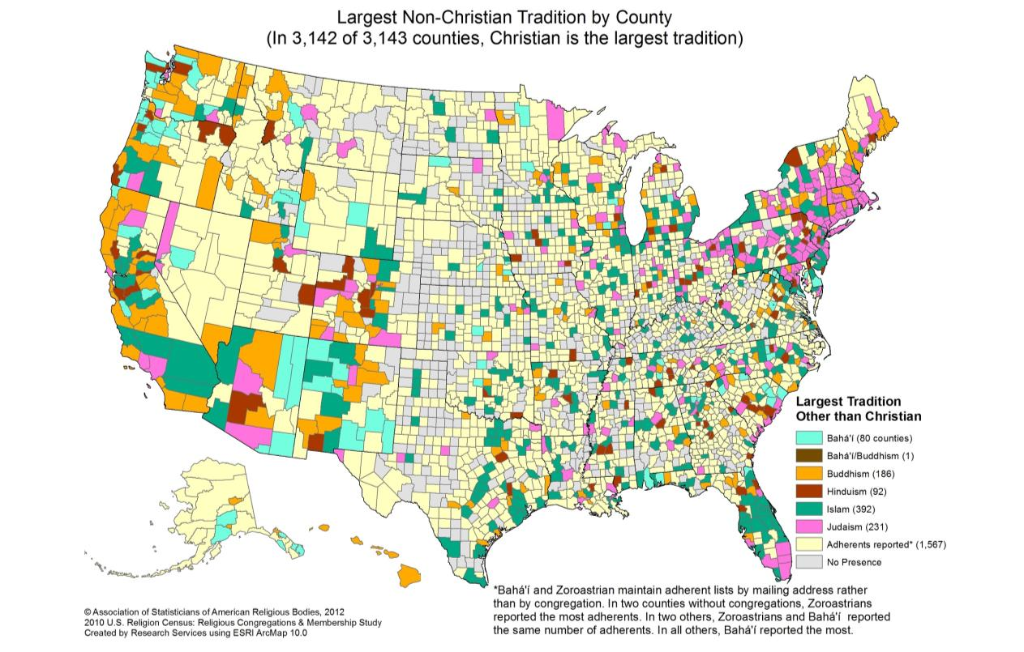
Largest Non-Christian Tradition by County

Slide 13
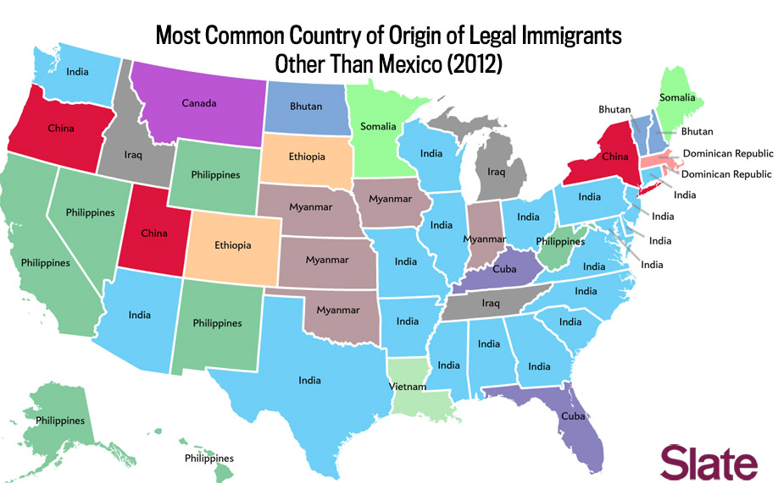
Most Common Country of Origin
Data Source: Department of Homeland Security
http://www.dhs.gov/profiles-legal-permanent-residents-2012-state/

Slide 14
Where We Are Today?
Faith communities have historically responded to disasters and human suffering – some are experts
Commitment from government for greater faith community engagement
Increasing interest from and need for faith communities to work with government in crisis settings, disasters and public health emergencies
Growing number of disaster interfaiths and disaster chaplaincy networks engaged throughout disaster lifecycle
Large knowledge gaps remain between the two
Lack of religious literacy and competency
Notes:
Students taking this course should know how to start the Approval and Collect Feedback workflows and understand how they work. Or, they can take the Microsoft Office Online training presentation titled, “Workflows I: Basics you should know” and “Workflows II: Collect feedback for a file.”
[Notes to trainer:
For detailed help in customizing this template, see the very last slide. Also, look for additional lesson text in the notes pane of some slides.
Adobe Flash animations: This template contains Flash animations. These will play in PowerPoint 2000 and later. However: If you want to save this template in PowerPoint 2007, save it in the earlier PowerPoint file format: PowerPoint 97-2003 Presentation (*.ppt) or PowerPoint 97-2003 Template (*.pot) (you’ll see the file types in the Save As dialog box, next to Save as type). Warning: If you save it in a PowerPoint 2007 file format, such as PowerPoint Presentation (*.pptx) or PowerPoint Template (*.potx), the animations won’t be retained in the saved file.
Also: Because this presentation contains Flash animations, saving the template may cause a warning message to appear regarding personal information. Unless you add information to the properties of the Flash file itself, this warning does not apply to this presentation. Click OK on the message.]

Slide 15
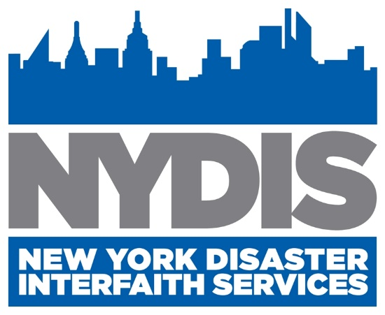
FAITH COMMUNITIES BUILDING PARTNERSHIPS FOR READINESS, RESPONSE, AND RECOVERY

Slide 16
History
Founded to coordinate 9/11 Recovery
A federation of 60+ faith-based human service providers, faith communities and faith-based philanthropies in NYC
Became 501(c)(3) in 2003
Focuses on under-served client populations and under-resourced faith communities.
Members task NYDIS to coordinated response and recovery efforts and to lead their disaster advocacy, preparedness, & training efforts
Maintains operational roles within NYC OEM disaster plans as well as DOH, HRA other government agencies and community-based NGOs (ARC, Human Services Council of New York & NYC VOAD
Lead and Co-Lead Agency Functions
Administrator: NYC Unmet Needs Roundtables
Administrator: Volunteer Group Housing Program
Emotional & Spiritual Care (Disaster Chaplaincy)
Faith Community Risk Communication

Slide 17
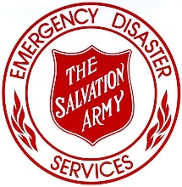
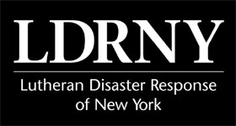
Membership
60+ Faith Communities & Faith-based Organizations
5,050 Clergy & Religious Leaders
3,800 Houses of Worship
3,670,000 Worshiping Members
Our Members Served 150,00 Clients Annually
NYDIS Trained 7,885 Religious Leaders in 2014
NYDIS Trained 360 Disaster Case Managers & Recovery Leaders

Slide 18
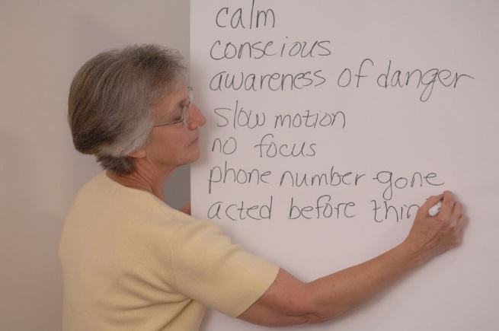
Programs
Capacity Building
Disaster Chaplaincy & Spiritual Care Training & Credentialing
Communications
Monthly E-News & Trainings
Risk Communication E-Alert System
Community Outreach: Mitigation Education & Preparedness Training
HOWCALM™ (Asset Mapping)
Planning: ARC, DOHMH, HSC, OEM & VOAD
Policy & Victim Advocacy
Training: ESC, Emergency Rest Center, MHFA & Ready New York
Relief & Recovery
Resources
Unmet Needs Roundtables
Volunteer Group Housing

Slide 19
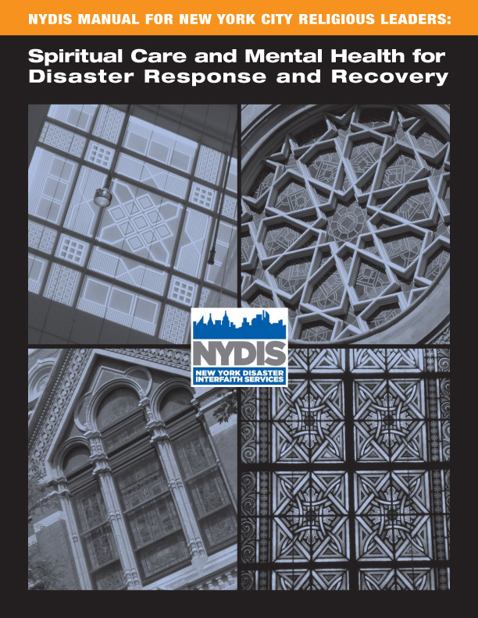
Best Practices Resources
Table of Contents
I. Preparation & Mitigation Phases
1 Disaster Response Planning & Preparedness
2 Faith Communities: Immediate/Long-Term Caregivers
3 Self-Care
4 Radical Hospitality: HOW Responding to Disaster
5 Developing Cultural Competence
II. Response & Recovery Phases
6 Conflict Transformation: Mitigating the Effect of Disaster
7 The Role of Religious Leaders in Trauma Response
8 Mental Health Response to a Disaster
9 The Context for Going to Help: Disaster Chaplains
III. Reference Section
10 Index of all Chapters’ Resource Citations
11 Glossary of Emotional States
12 Age-Specific Reactions and Interventions
13 New York City Government Response
14 Primary National Volunteer Response Organizations
15 NYC Disaster Response Agencies and Organizations
16 Incident Command System
17 New York State Government Response to Disaster
18 Federal Response to Disaster

Slide 20
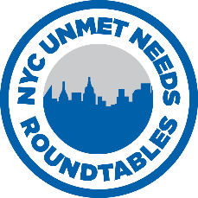
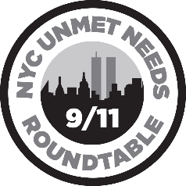
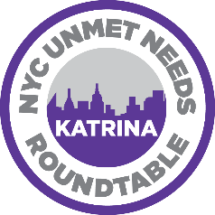
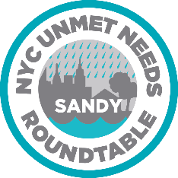
Unmet Needs Roundtables (UNR)
NYDIS is the lead agency to activate and administer all long-term recovery Unmet Needs Roundtables in New York City.
Brings together donors and disaster case management to award financial assistance and services to survivors and victim’s families with unmet needs.
Types of Assistance
Sustainable Recovery Assistance
Emergency Assistance
Legal Referral
Mental Health & Spiritual Care Referral
NYDIS Trains all Disaster Case Managers and Supervisor on how to access the UNR and develop applications to meet the expectations of donors
NYDIS fundraises for and oversees the NYC Unmet Needs Fund ($22M to Date)
Lead agency to manage the Exit Interiews/Unmet Needs Assessments in all NYC OEM DASC Operations and for the CAN/Case Management Coordination Committee of New York City VOAD & the Human Services Council of New York
NYDIS and Spark Relief USA manage www.unmetneedsroundtables.org - a secure online application portal and client/donor data tracking and reporting tool that is used in New York State and now available nationally.

Slide 21
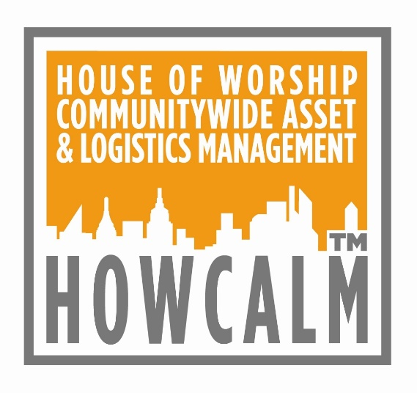
Faith Community Asset Mapping
HOWCALM®
House of Worship Communitywide Asset & Logistics Management
A secure, online, proprietary database system that tracks the logistics and resources of:
Houses of Worship
Religious Schools
Faith-based Disaster Human Service Providers
Holds 5 Tiers of Data:
Tier 1 — Location & Senior Leaders
Tier 2— Emergency Contacts
Including Senior Staff with Disaster-related Credentials
Tier 3— Facilities & Programs
Physical Plant, Facilities, & Equipment
Community-Based Outreach & Social Services
Personnel Skills and Languages
Tier 4— Geographic Information Systems (GIS)
Maps Location and All-hazards Vulnerabilities
Tier 5— Homebound Congregant Registry
For congregants unable to self-evacuate

Slide 22
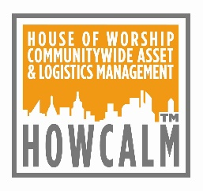
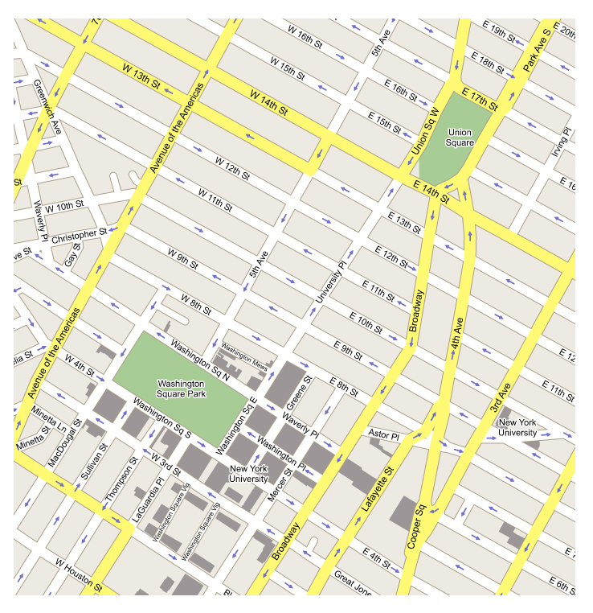
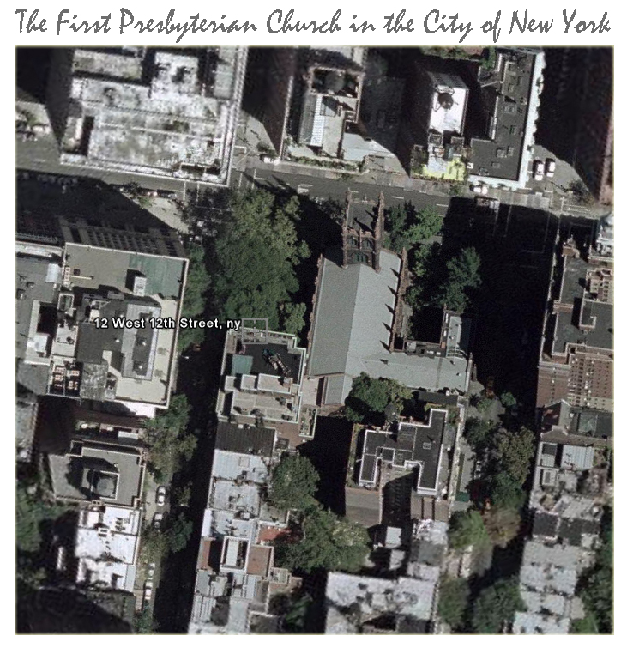
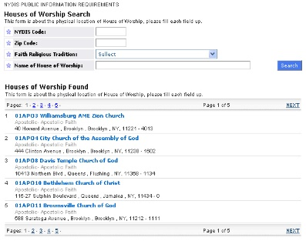
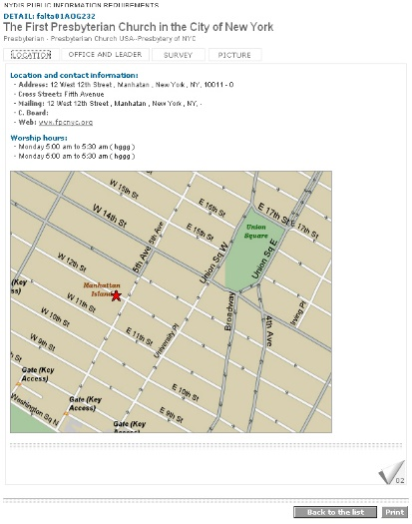
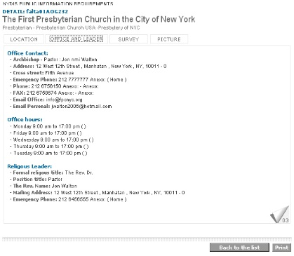
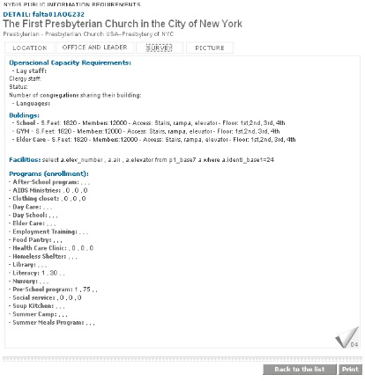
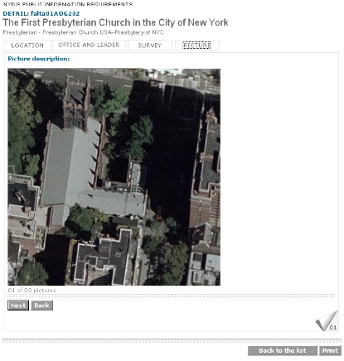
Faith Community Asset Mapping
7,000 Geo-Coded and Mapped FBOs
1300 Flood Zone Mapped HOW
300 Critical Sites Mapped

Slide 23
Activations & Recovery TimeLine
Terrorist Attacks, September 11, 2001
Anthrax Attacks, October 2001
Flight 587 Crash, November 12, 2001
Northeast Power Grid Blackout, August 14, 2003
Staten Island Ferry Crash, October 15, 2003
21” Blizzard, January 20, 2004
Hurricanes Katrina/Rita Evacuations & Resettlement, August 2005
27” Blizzard, February 10, 2006
Queens Blackout, July 17-25, 2006
Staten Island Nor’easter, April 14, 2007
Brooklyn-Queens Tornado & Flood, August 8, 2007
Turtle Bay Crane Collapse, March 18, 2008
H1N1 Outbreak, Spring 2009
Haiti Earthquake Evacuations & Resettlement, Winter 2010
SuperStorm Sandy, Fall 2012
East Harlem Build Explosion, Spring 2014
MERS Risk Communication Support of CDC, Spring 2014

Slide 24
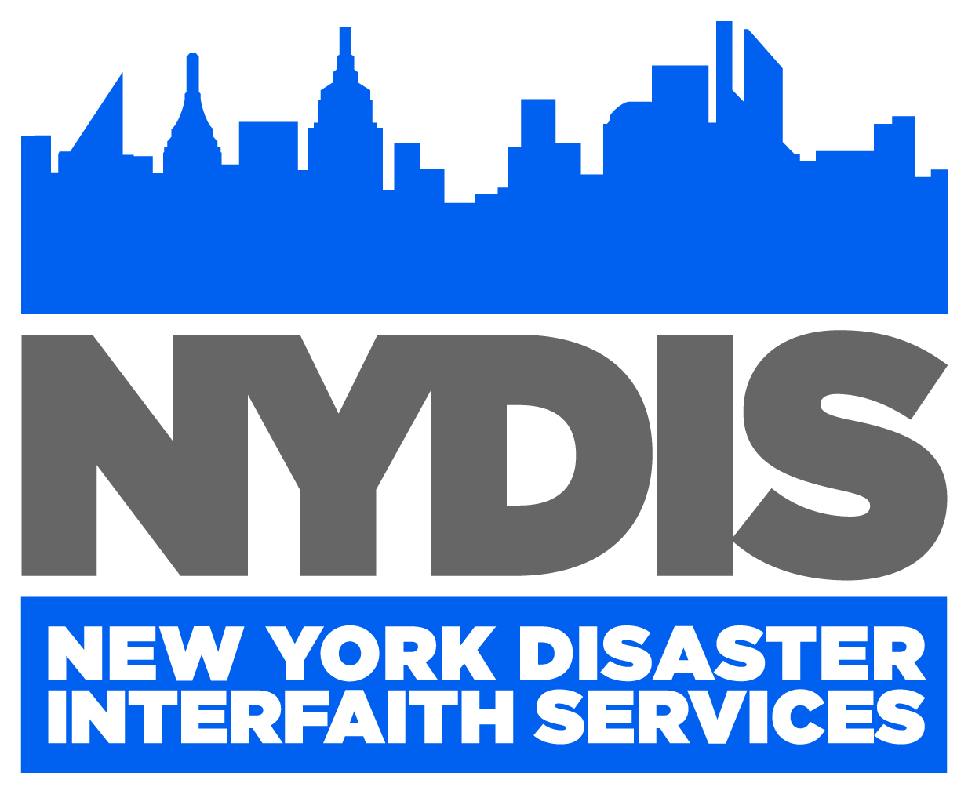
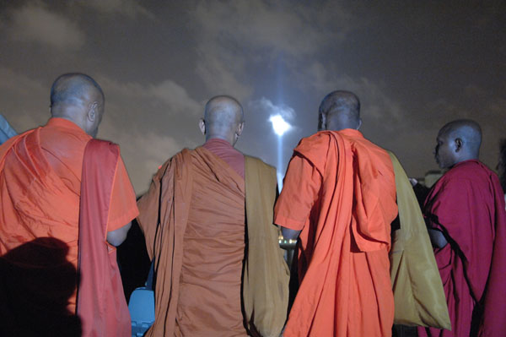
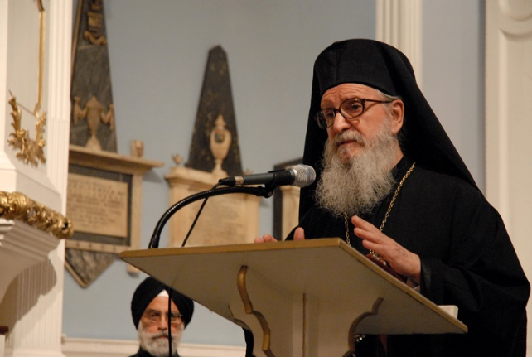
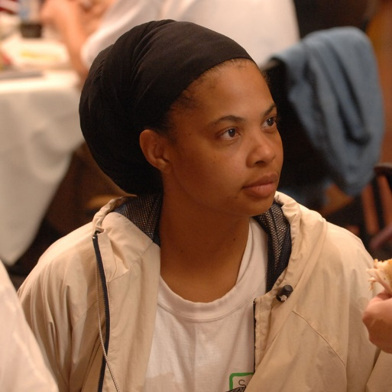
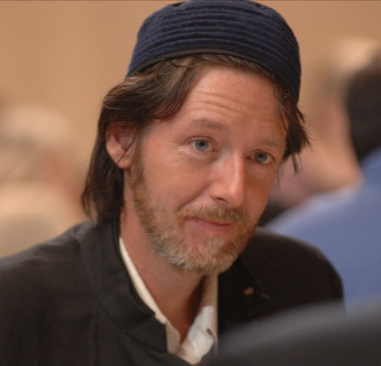
Contact NYDIS:
4 West 43rd Street – Suite 604
New York, NY 10036
Phone: 212.669.6100
Email: info@nydis.org
www.nydis.org

Slide 25
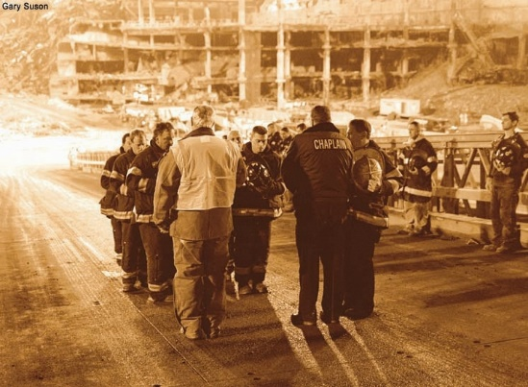
Religious Literacy & Competency

Slide 26
Defining Religious Literacy & Competency
Religious Literacy
A basic understanding of the history, sacred texts, beliefs, rituals and current manifestations of multiple faith traditions.
The ability to understand the intersection of religious groups and the social, political and cultural life of the larger communities they inhabit.
Religious Competency
in a Disaster
Knowing how to navigate and engage each faith community as a trusted, knowledgeable and effective partner in a disaster setting.
One doesn’t need to become a scholar of religion to improve religious competency.
Aim for “a little of Column A, and a lot of Column B”!

Slide 27
Religious Competency in Disaster is Key to Effective Partnerships
Religious competency is:
Providing culturally and religiously appropriate disaster services to the whole community.
Knowing and understanding the community where you work.
Understanding the needs, concerns and missions of your partners both locally and nationally.
Relationship-building that is trustworthy and sustainable.
Being more effective in the field.
Religious competency is not:
Checking the box.
Being politically correct.
Meeting so-called “inappropriate” needs.
Notes:
Last bullet point: These are not special needs, these are core needs.
(You would not go on a job interview without knowing about the company with which you are interviewing.)
If there is a greater understanding of religious traditions it can also help protect those that are not members of congregations.
Native American example: Event where Operation Hope teaching about disaster preparedness. Audience member says “well we don’t prepare for disaster”. We take what comes from mother earth. So religious literacy is important to be aware of ways to present and customize presentation to meet the needs of the community they are working with.
Another example: SBA loans for Muslim communities, would not be relevant as this community does not take loans. So not having religious literacy could mean time of everyone gets wasted if info not presented in competent way.
In LDS community, responsibility is on individual family. They not do not generally think about providing assistance outside the community. Differing beliefs about who is responsible for who, etc.
American Red Cross in Greater LA – Creating partnerships with mosques – starting tiering the mosques in terms of how open they were to general public. So some became ARC shelter partners, others were trained in how to best support those who would not be comfortable in a traditional ARC shelter setting.

Slide 28
EM Speaks a Different Language

Slide 29
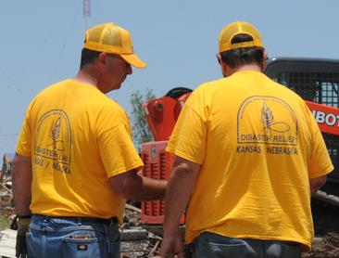
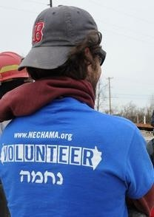
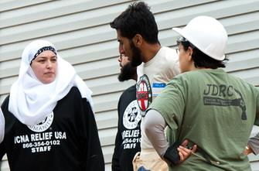
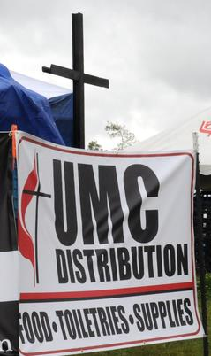
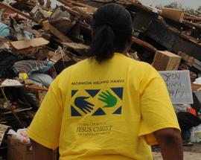
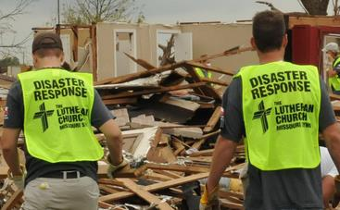
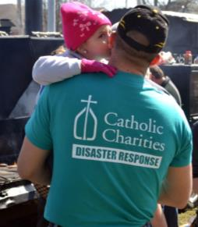
Faith Communities’ Disaster Language
CCUSA●CWS●ERD●ICNA Relief USA●IOCC
IRUSA●JDRC●LDR●MDS●PDA●TSA●UMCOR

Slide 30
Quiz: Familiar Religious Symbols

Slide 31
Quiz Answers: Familiar Religious Symbols
Christian Cross (Christianity)
Buddha (Buddhism)
Star of David (Judaism)
Crucifix (Roman Catholicism and Christian Orthodox churches)
Ganesh (Hiduism)
Star and Crescent (Islam)

Slide 32
Quiz: Less Familiar Religious Symbols

Slide 33
Quiz Answers: Less Familiar Symbols
Faravahar (Zoroastrianism)
Om (Hinduism, Buddhism, Jainism)
Chai (Judaism)
Khanda (Sikhism)
Mezuzah(Judaism)
Torii Gate (Shintoism)
Allah (Islam)
Chi-Rho (Christianity)
Dharma Wheel (Buddhism)
Swastika (Hinduism)

Slide 34
Learn Faith Communities’ Own Terms
You demonstrate competency and genuine interest in stakeholders when you use terms that resonate with them and are inclusive.
Clergy Refers only to ordained, often Christian leaders. Not all religions have clergy (e.g. Sikhs, Muslims). | Religious Leaders Term which includes leaders of any religious tradition whether ordained or not.
Church The building where most Christian denominations worship. | House of Worship The building (church, gurdwara, mosque, synagogue, temple, etc.) where adherents of a given religion worship.
Church/House of Worship The building. | Congregation The people.

Slide 35
Religious Landscape
Judicatory/
Denomination
Community Organizing
Network
Congregation
Faith-based Non-Profit
Association/Alliance
Notes:
Congregations have affiliation with National faith-based orgs, but not always a strong link: e.g. UMCOR does not always have links with local Methodist churches.
VOAD: Voluntary Organizations Active in Disasters
CARD: Collaborating Agencies Responding to Disasters
LTRO: Long-Term Recovery Organization; will form in areas where there have been a disaster. Typically made up of faith-based groups including congregations. Can serve as a link between local congregations and national VOAD affiliates.
This is an area where collaboration is important with FEMA Voluntary Agency Liaisons.
Example: When Church of Scientology disaster chaplains arrived at a Harlem, NYC building collapse in 2014, they were not allowed in to Family Assistance Centers, even though they were members of National VOAD. Highlights importance of inter-operation between Offices of Emergency Management and local VOADs.

Slide 36
Landscape of Religion & Disasters
National Organizations
National Faith-based Disaster Response Org
Disaster Chaplaincy
National VOAD & Members
Judicatory/
Denomination
Community Organizing
Network
Congregation
Faith-based Non-Profit
Local Organizations
VOAD/COAD/CARD
LTRO
Disaster Interfaith
Disaster Chaplaincy
CERT/Citizen Corps
Association/Alliance
Notes:
Congregations have affiliation with National faith-based orgs, but not always a strong link: e.g. UMCOR does not always have links with local Methodist churches.
VOAD: Voluntary Organizations Active in Disasters
CARD: Collaborating Agencies Responding to Disasters
LTRO: Long-Term Recovery Organization; will form in areas where there have been a disaster. Typically made up of faith-based groups including congregations. Can serve as a link between local congregations and national VOAD affiliates.
This is an area where collaboration is important with FEMA Voluntary Agency Liaisons.
Example: When Church of Scientology disaster chaplains arrived at a Harlem, NYC building collapse in 2014, they were not allowed in to Family Assistance Centers, even though they were members of National VOAD. Highlights importance of inter-operation between Offices of Emergency Management and local VOADs.

Slide 37
Faith-based Engagement Plan
The five steps to creating an engagement plan are:
LEarn The Disaster and Your Role
Access Local Faith Community Data
Determine Engagement Plan
Engage Leaders and Communities
Review and Continuously Improve Plan
Utilize religious hierarchies and networks first before going door to door.
Develop a written engagement plan.
Learn cultural/religious “Dos” and “Don’ts”.

Slide 38
What to Do Next
Train on religious landscape, ecology & partners
Engage only what can be sustained
Be honest and offer before you “ask for”
Assess Competency in Planning & Response
Coordinate FBO engagement across sectors
Plan/Exercise with Children & FBOs
Create competent materials and trainings which specifically address needs of children/families
Repeat – the landscape is always changing
Notes:
Learn the area’s faith landscape
Become religiously literate
Have clear objectives and goals for engagement
Ensure that engagement efforts have real value for faith communities
Impact policy and not just serve PR purposes
Work with existing networks or coalitions or associations
Coordinate across agencies to avoid cross outreach overload
Meet with religious leaders to honestly discuss past experiences, and current concerns about working with government agencies.
Build and maintain on-going relationships with religious leaders
Provide cultural, religious literacy and competency training for elected officials, emergency managers, public health officials, and first responders.

Slide 39
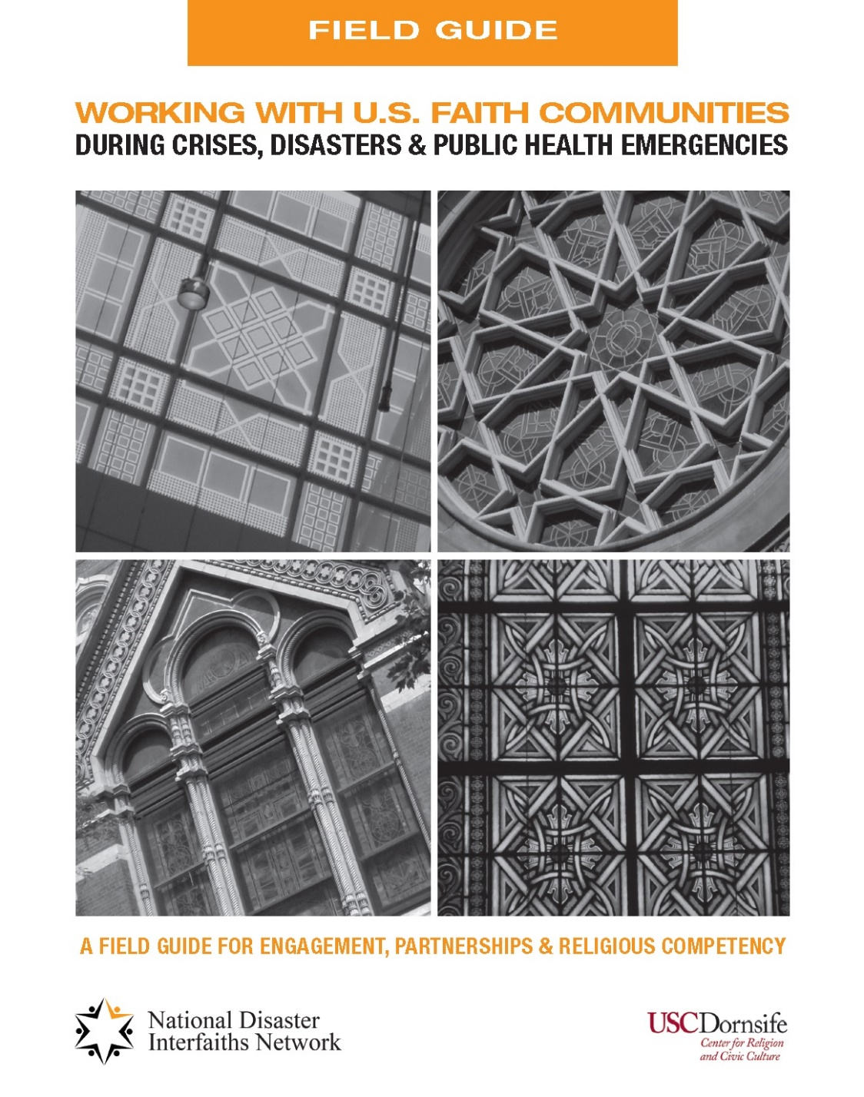
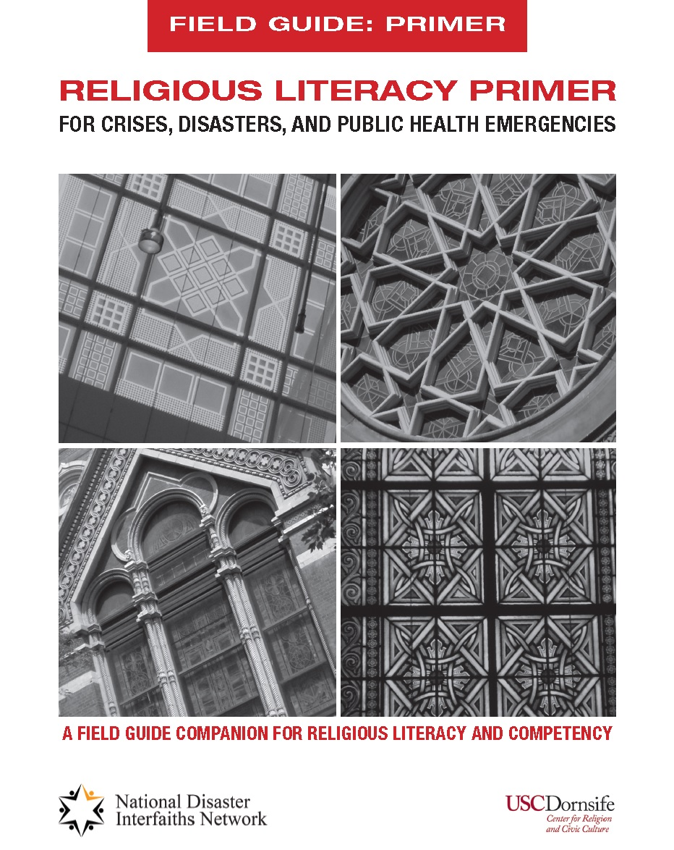

Slide 40
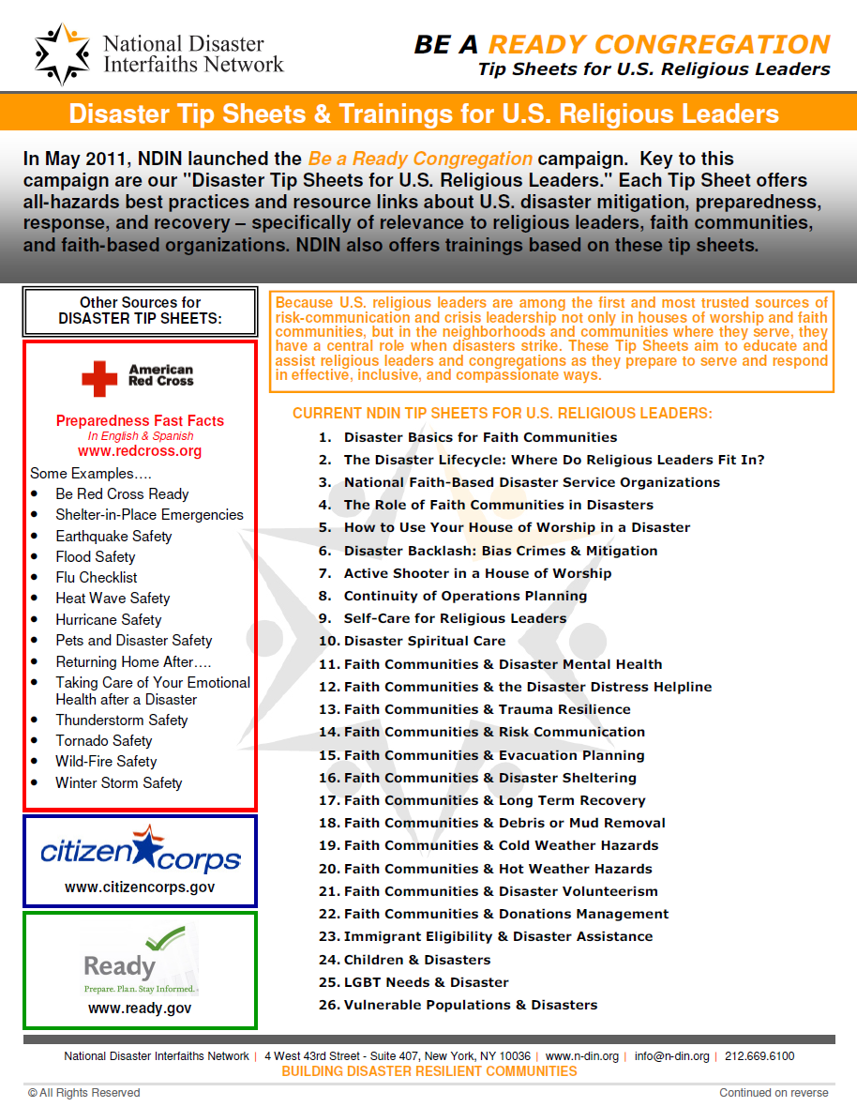
Be A
READY CONGREGATION
26 Tip Sheets for
U.S. Religious Leaders

Slide 41
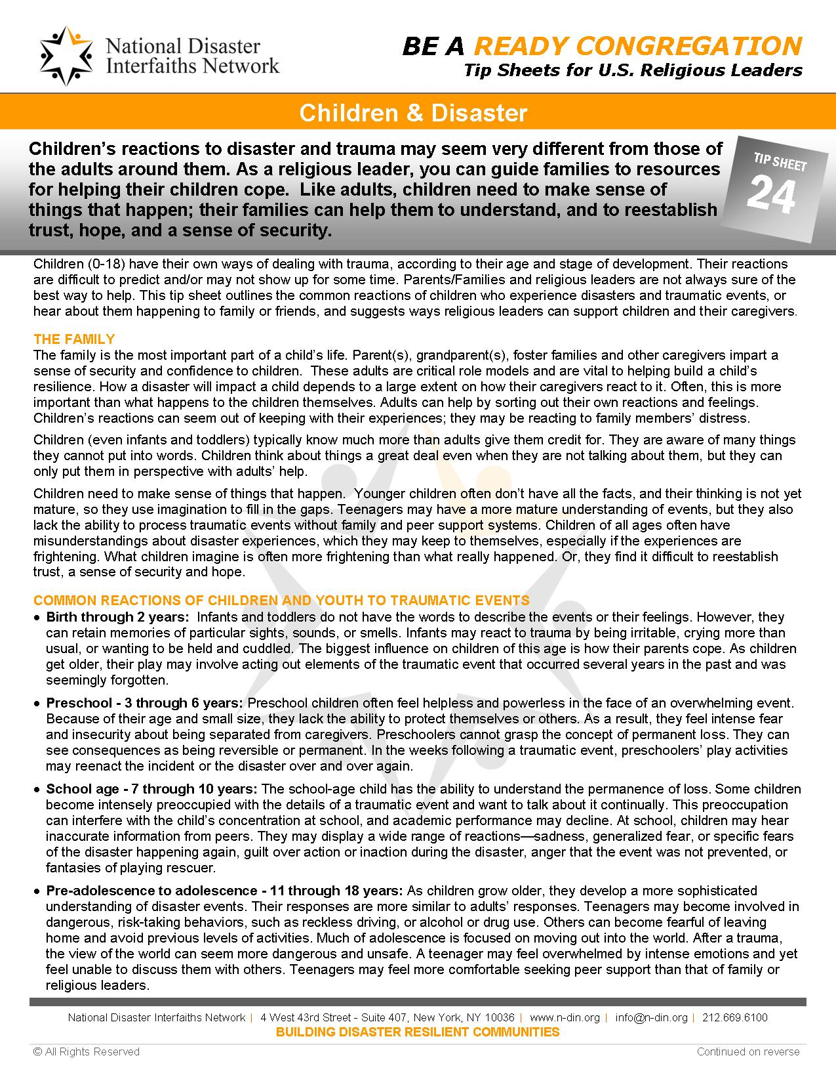
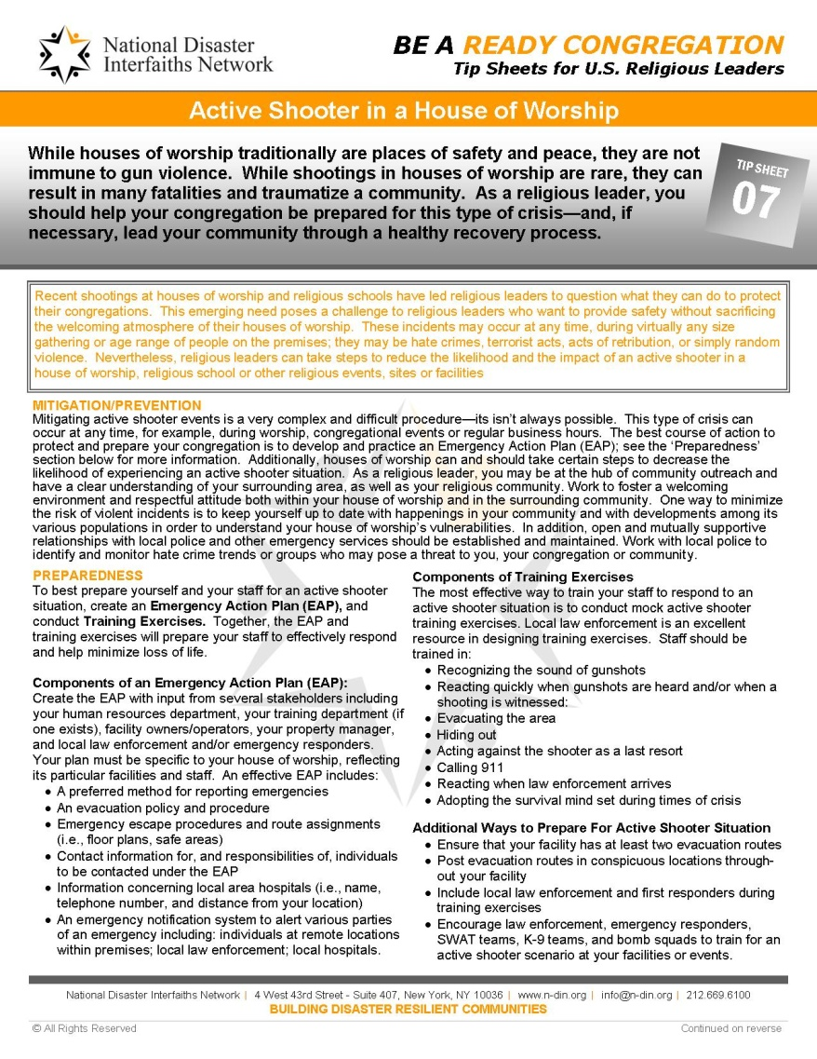
Be A
READY CONGREGATION
Tip Sheet:
Children
& Disasters
Tip Sheet:
Active Shooter

Slide 42
Tip Sheets for
Faith Community Partners
Competency Guidelines for Sheltering &
Mass Care
Buddhist
Hindu
Jewish
Muslim
Sikh

Slide 43
RELIGIOUS LITERACY:
By Stephen Prothero
What Every American Needs to Know –
And Doesn’t

Slide 44
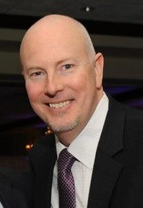
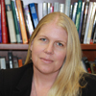
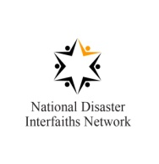
Literacy & Competency Project Team
Peter Gudaitis, President, National Disaster Interfaiths Network (NDIN) | Brie Loskota, Managing Director, USC Center for Religion and Civic Culture | Tyler Radford, Sr. Program Officer National Disaster Interfaiths Network (NDIN)

Slide 45
Peter B. Gudaitis, M.Div. President, National Disaster Interfaiths Network Chief Response Officer, New York Disaster Interfaith Services Adjunct Professor, Hartford Seminary Research Associate, USC Center for Religion & Civic Culture 4 West 43rd Street, Suite 407 New York, NY 10036 pgudaitis@n-din.org │www.n-din.org

